Slide 1
Tableau Hands-On Nabil Beitinjaneh

Slide 2
Emergency Department Visualization
The objective is to recreate a visualization
Import the Emergency Department dataset
Recreate each of the sheets
Two sets of screen captures will be provided
The graph
The graph with extra information
The visualization is also available on the Dropbox

Slide 3
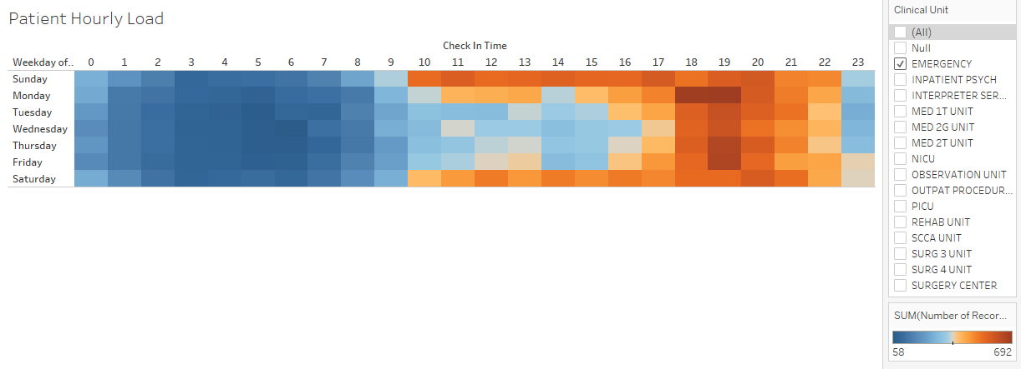
Emergency Department Visualization
Patient Hourly Load for Emergency Department

Slide 4
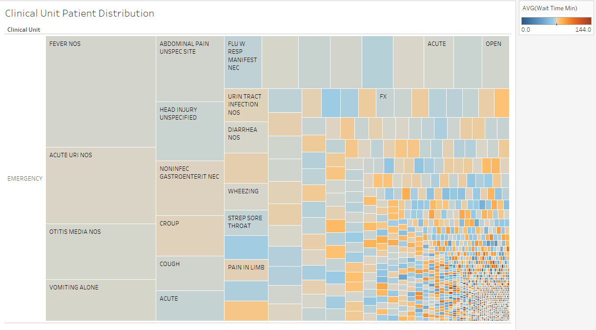
Emergency Department Visualization
Clinical Unit Patient Distribution
This viz shows the most common diagnoses in the Emergency Clinical Unit (the larger the box, the more common the diagnosis). Color depicts the average wait time for that diagnosis.

Slide 5
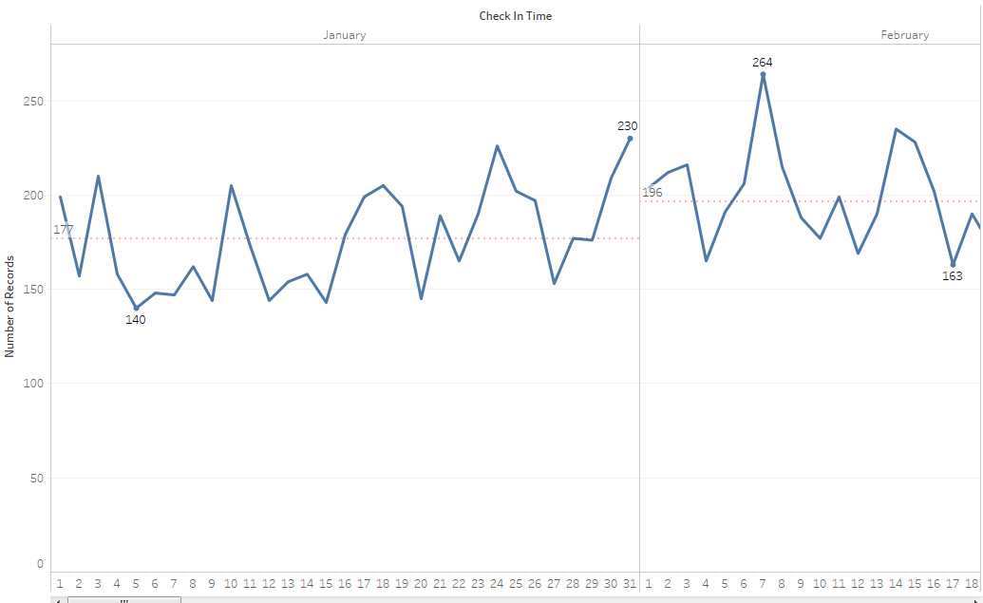
Emergency Department Visualization
Daily Averages
This viz shows the number of daily check-ins for the EMERGENCY Clinical Unit
The busiest and least busy days of each month are indicated, along with the mean for each month

Slide 6
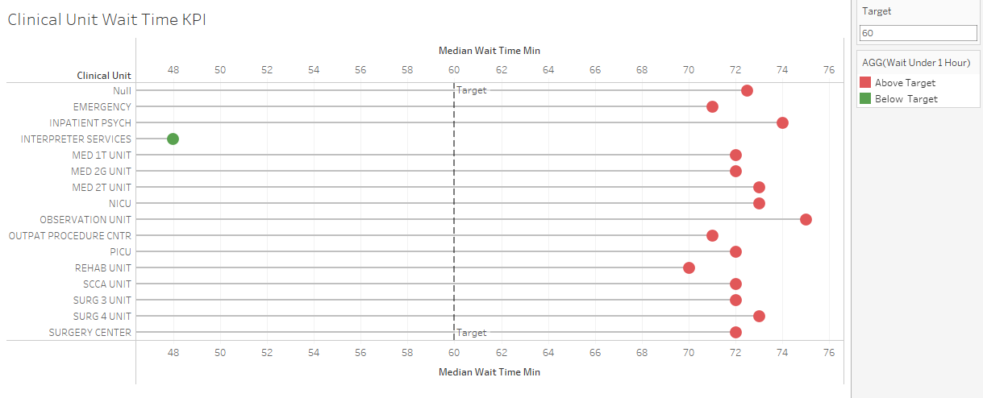
Emergency Department Visualization
Clinical Unit Wait Time KPI
This viz shows the number of daily check-ins for the EMERGENCY Clinical Unit
The busiest and least busy days of each month are indicated, along with the mean for each month

Slide 7
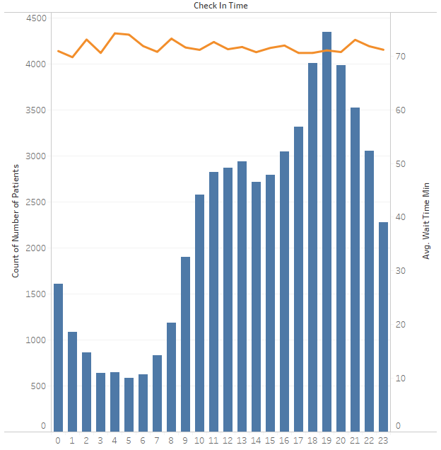
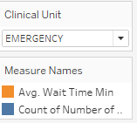
Emergency Department Visualization
Busy Times of the day

Slide 8
Emergency Department Visualization
More Detailed Screen Captures

Slide 9
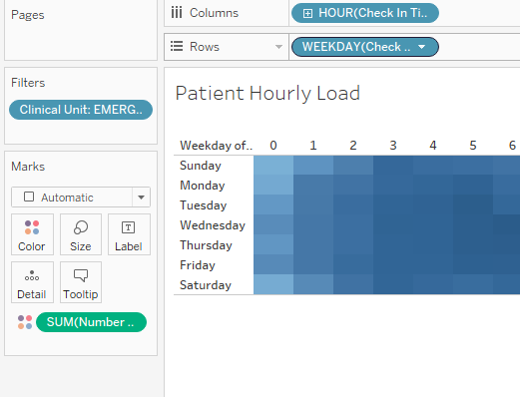
Emergency Department Visualization
Patient Hourly Load for Emergency Department

Slide 10
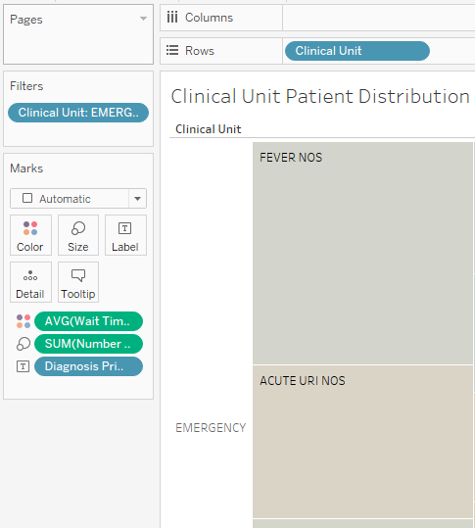
Emergency Department Visualization
Clinical Unit Patient Distribution

Slide 11
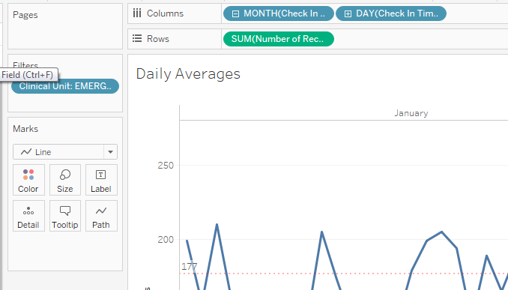
Emergency Department Visualization
Daily Averages

Slide 12
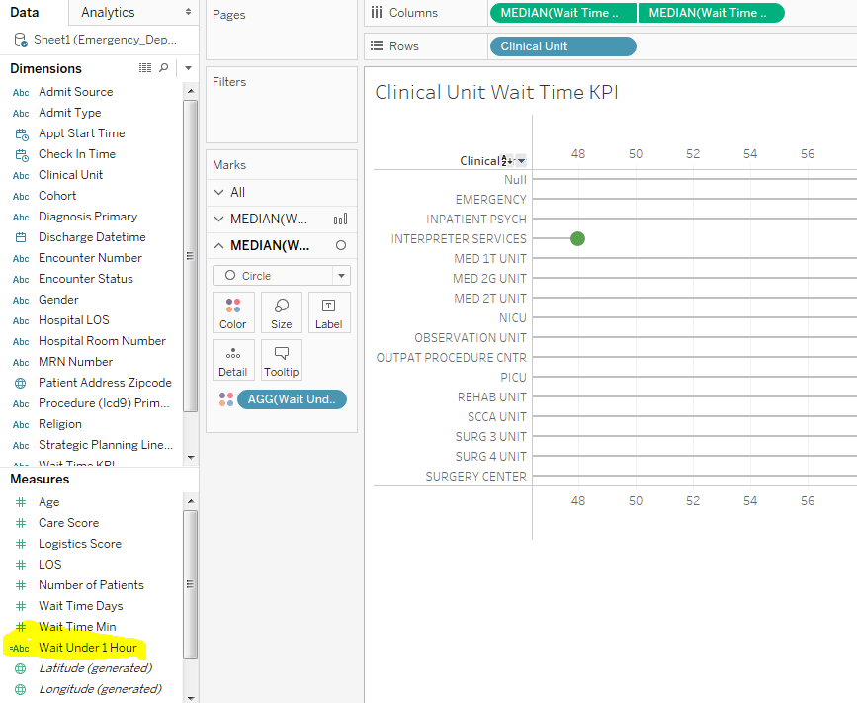
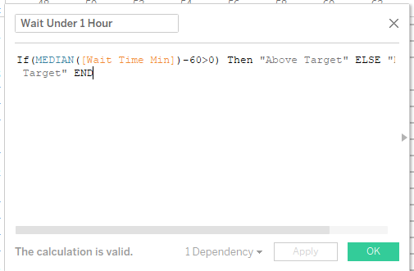
Emergency Department Visualization
Clinical Unit Wait Time KPI
If(MEDIAN([Wait Time Min])-60>0) Then "Above Target" ELSE "Below
Target" END

Slide 13
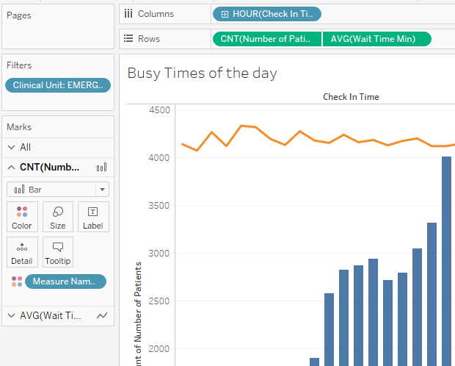
Emergency Department Visualization
Busy Times of the day

